Slide 1
COMPREHEND COPE AND CONNECT BITE-SIZED TRAINING
TAKING CHARGE OF YOUR LIFE
(Emotional Coping Skills)

Slide 2
The Taking Charge of your Life
Emotional Coping Skills tailored to fit with CCC – to help people break their vicious cycles and learn how to manage better.
ECS approach derives from DBT.
6 Session programme covering: mindfulness; understanding feelings; managing your feelings; managing urges and distress; people skills and keeping it up.
Sensitive issues might be touched on – so participants might need support afterwards
Skills practice is given at the end of each session. Ward staff have a vital role to support people with this in their one to ones.

Slide 3
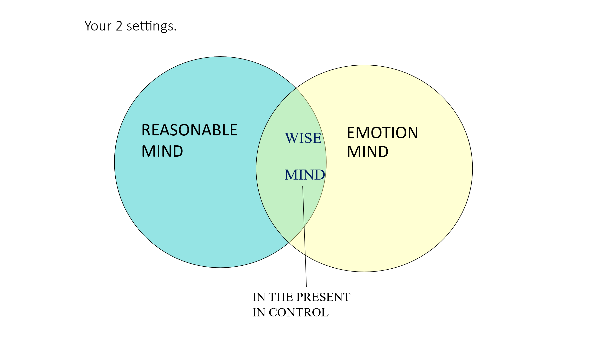
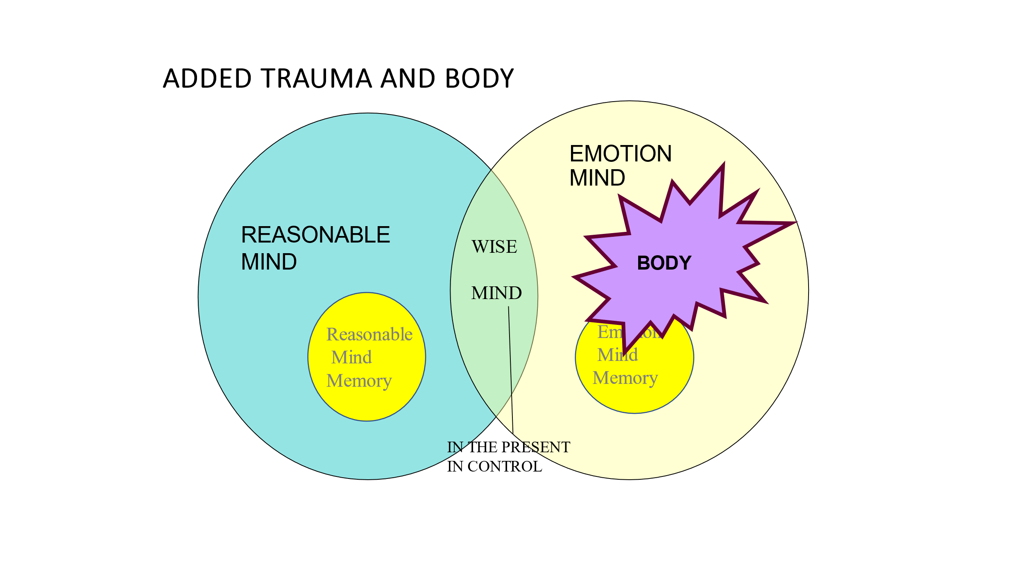
Session 1 Mindfulness
Rationale for Mindfulness – States of Mind
Being in touch with both Reasonable and Emotion Mind, but not taken over by either = Key to Emotion Management = ability to Take Charge of your Life!
Awareness of the role of trauma and the body explains why Emotion Mind is so powerful, and why getting into Wise Mind and staying there is difficult
Notes:
All the groups linked to CCC aim to reinforce the central rationale of the States of Mind. Key idea – helping people not to be controlled by Emotion Mind, the Past and the Body, but take control for themselves and in their real best interest. The place to start is always Wise Mind. Get there by bringing down arousal (breathing, relaxation, pleasant activity) or raising it – concentrated activity in the present – word search and jig saw for starters.

Slide 4
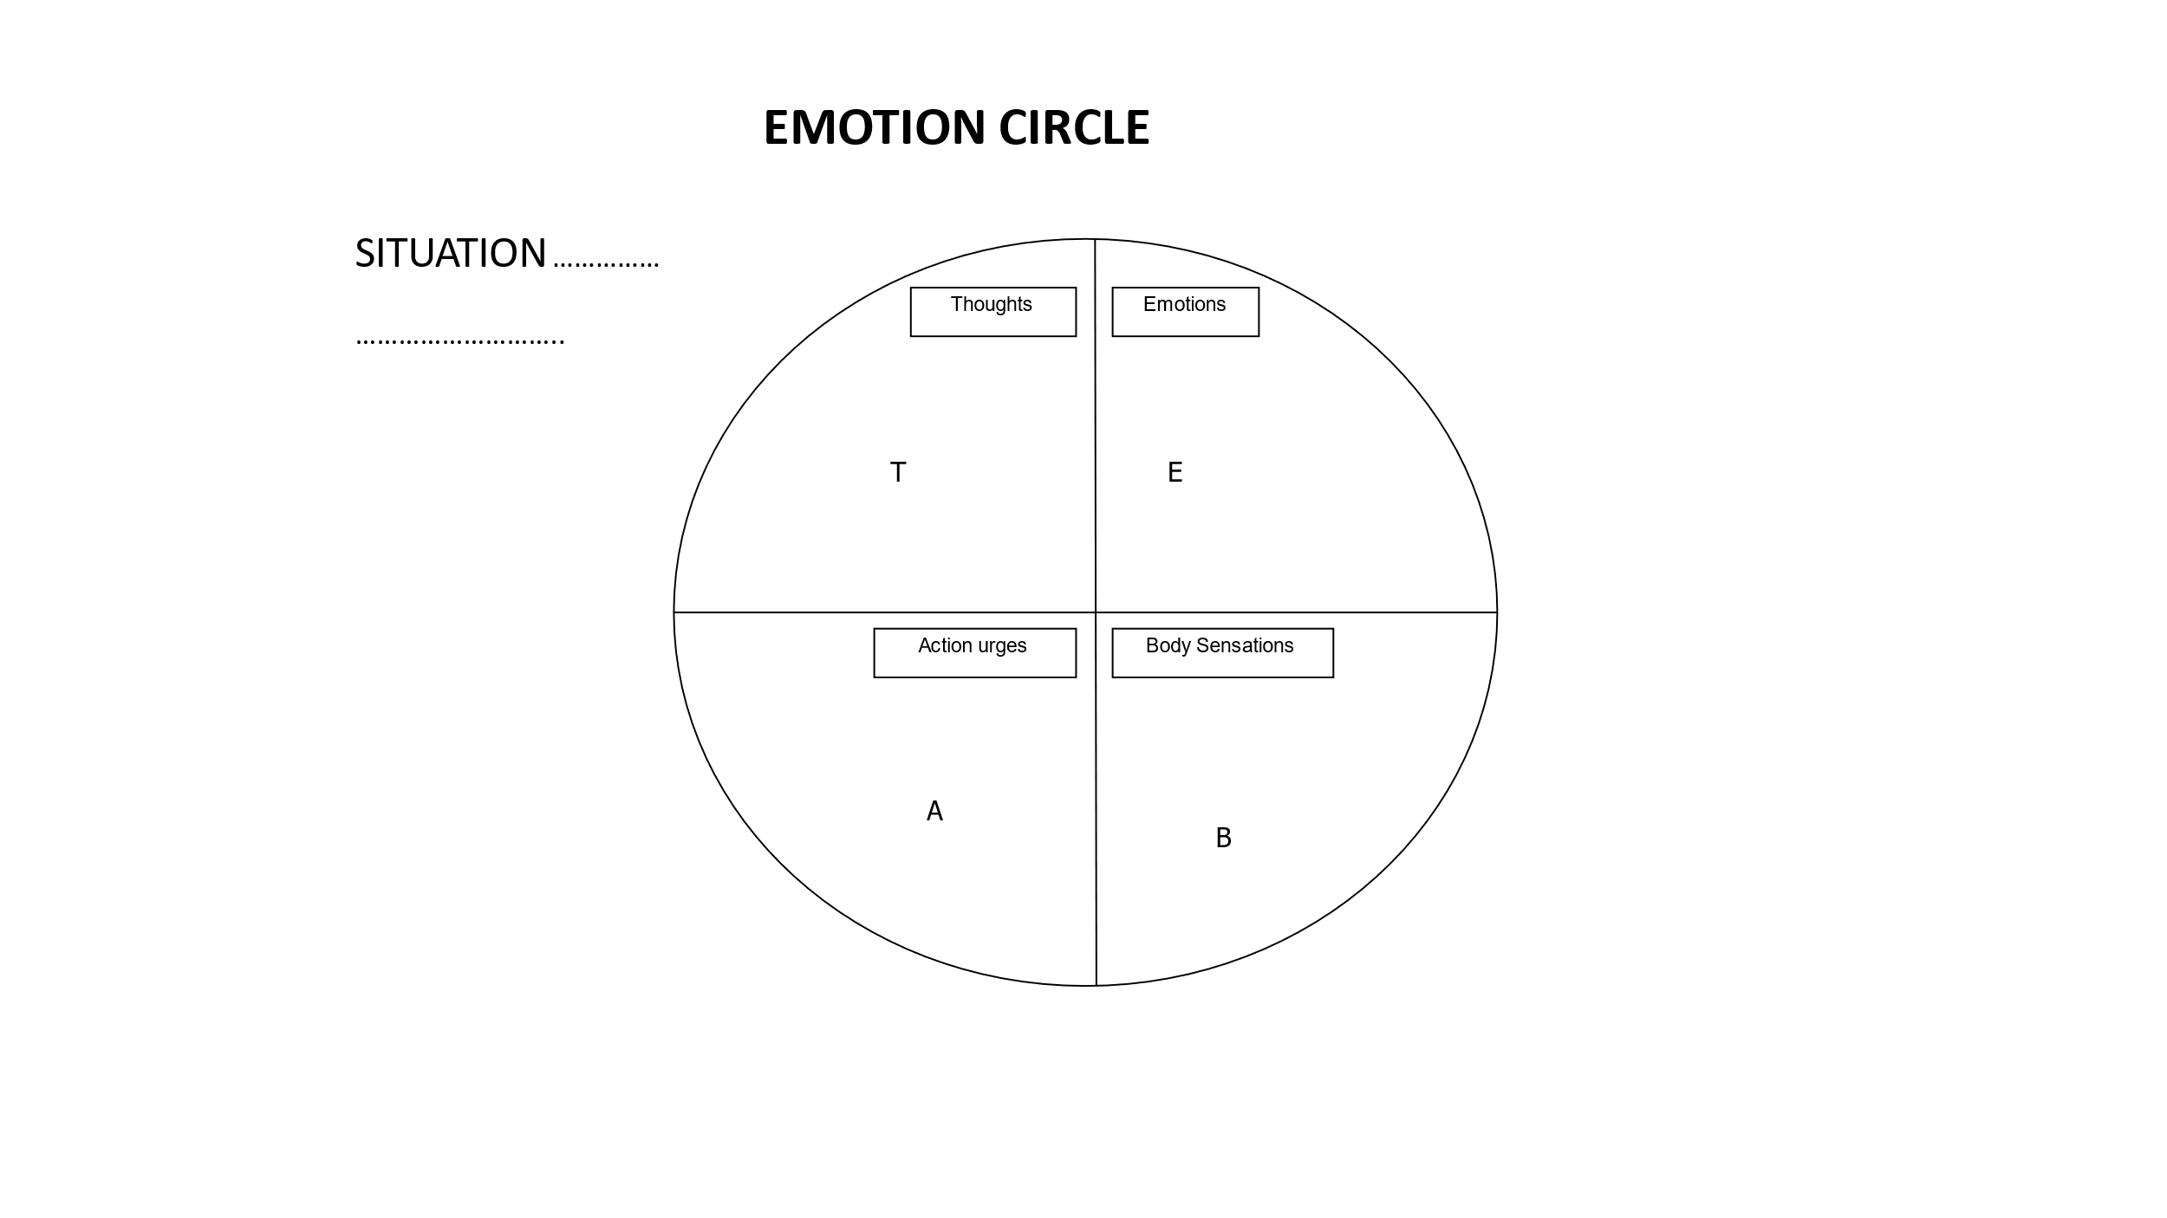
Session 2. Understanding Feelings
An emotion is like a wave – it might feel overwhelming when you are in the middle of it;
Acting on it might feel inevitable – but, if you can just stay with it; let it wash over, learn that it is self limiting
Emotion Circle – Hot Cross Bun – can be used to break down a difficult emotion. Understand where it is coming from. Step aside from it.
Notes:
Discussion on how this could be used to help someone deal with urges to self harm etc. If time, illustrate mindfulness of an emotion (brief delivery) to get the idea of reducing the emotion to an event in the body.

Slide 5
Session 3. Managing Feelings
The wave needs to flow – feelings need safe expression. Questions asked in the group:
What makes you joyful?
  How do you express that joy?
What makes you sad?
  How do you express that sadness?
What makes you fearful?
  How do you express that fear?
What makes you angry?
  How do you express that anger?
Notes:
Discussion on how staff might support their patients to face and express their feelings safely - eg. support tears for sadness; physical and creative activity for anger; facing and planning to master fear at a manageable pace etc.

Slide 6
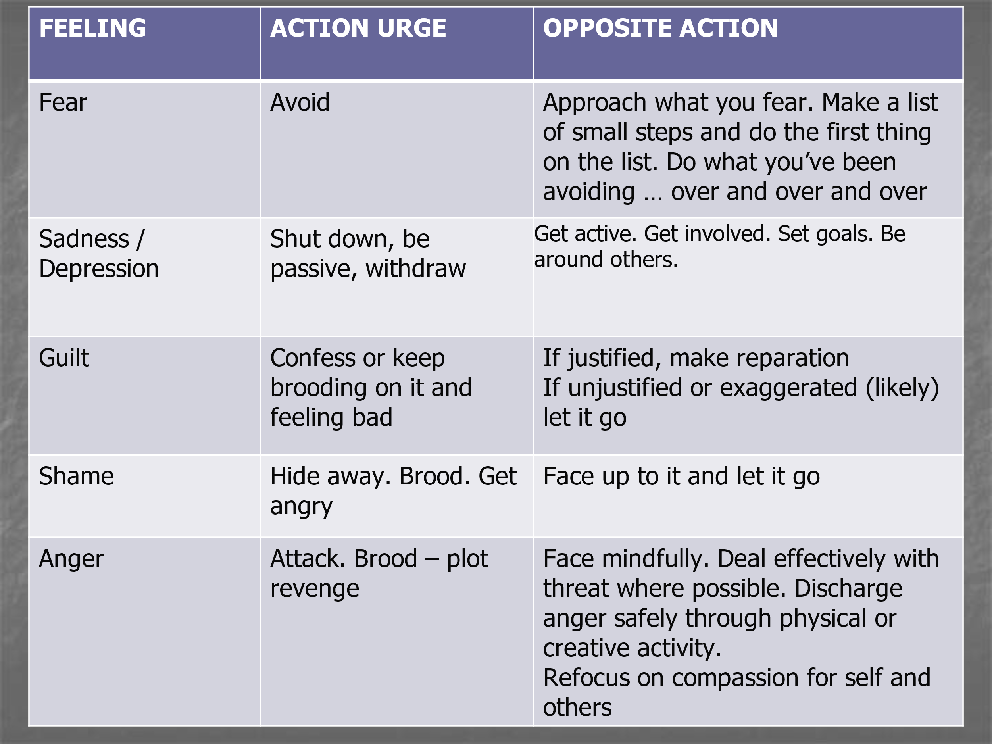
Acting Opposite and Staying out of Emotion Mind
STRENGTH
Sleep
Take care of yourself
Resist unhelpful behaviours
Exercise
Nutrition
Gain mastery
Take time for yourself
Healthy self-talk
Sleep, regular healthy food, exercise, self care and looking after health; taking time for self – activities the person enjoys, is good at – are all areas that ward staff are well placed to support people with.
They all impact directly on emotion management.
Notes:
Discuss this point and come up with examples from current patients.

Slide 7
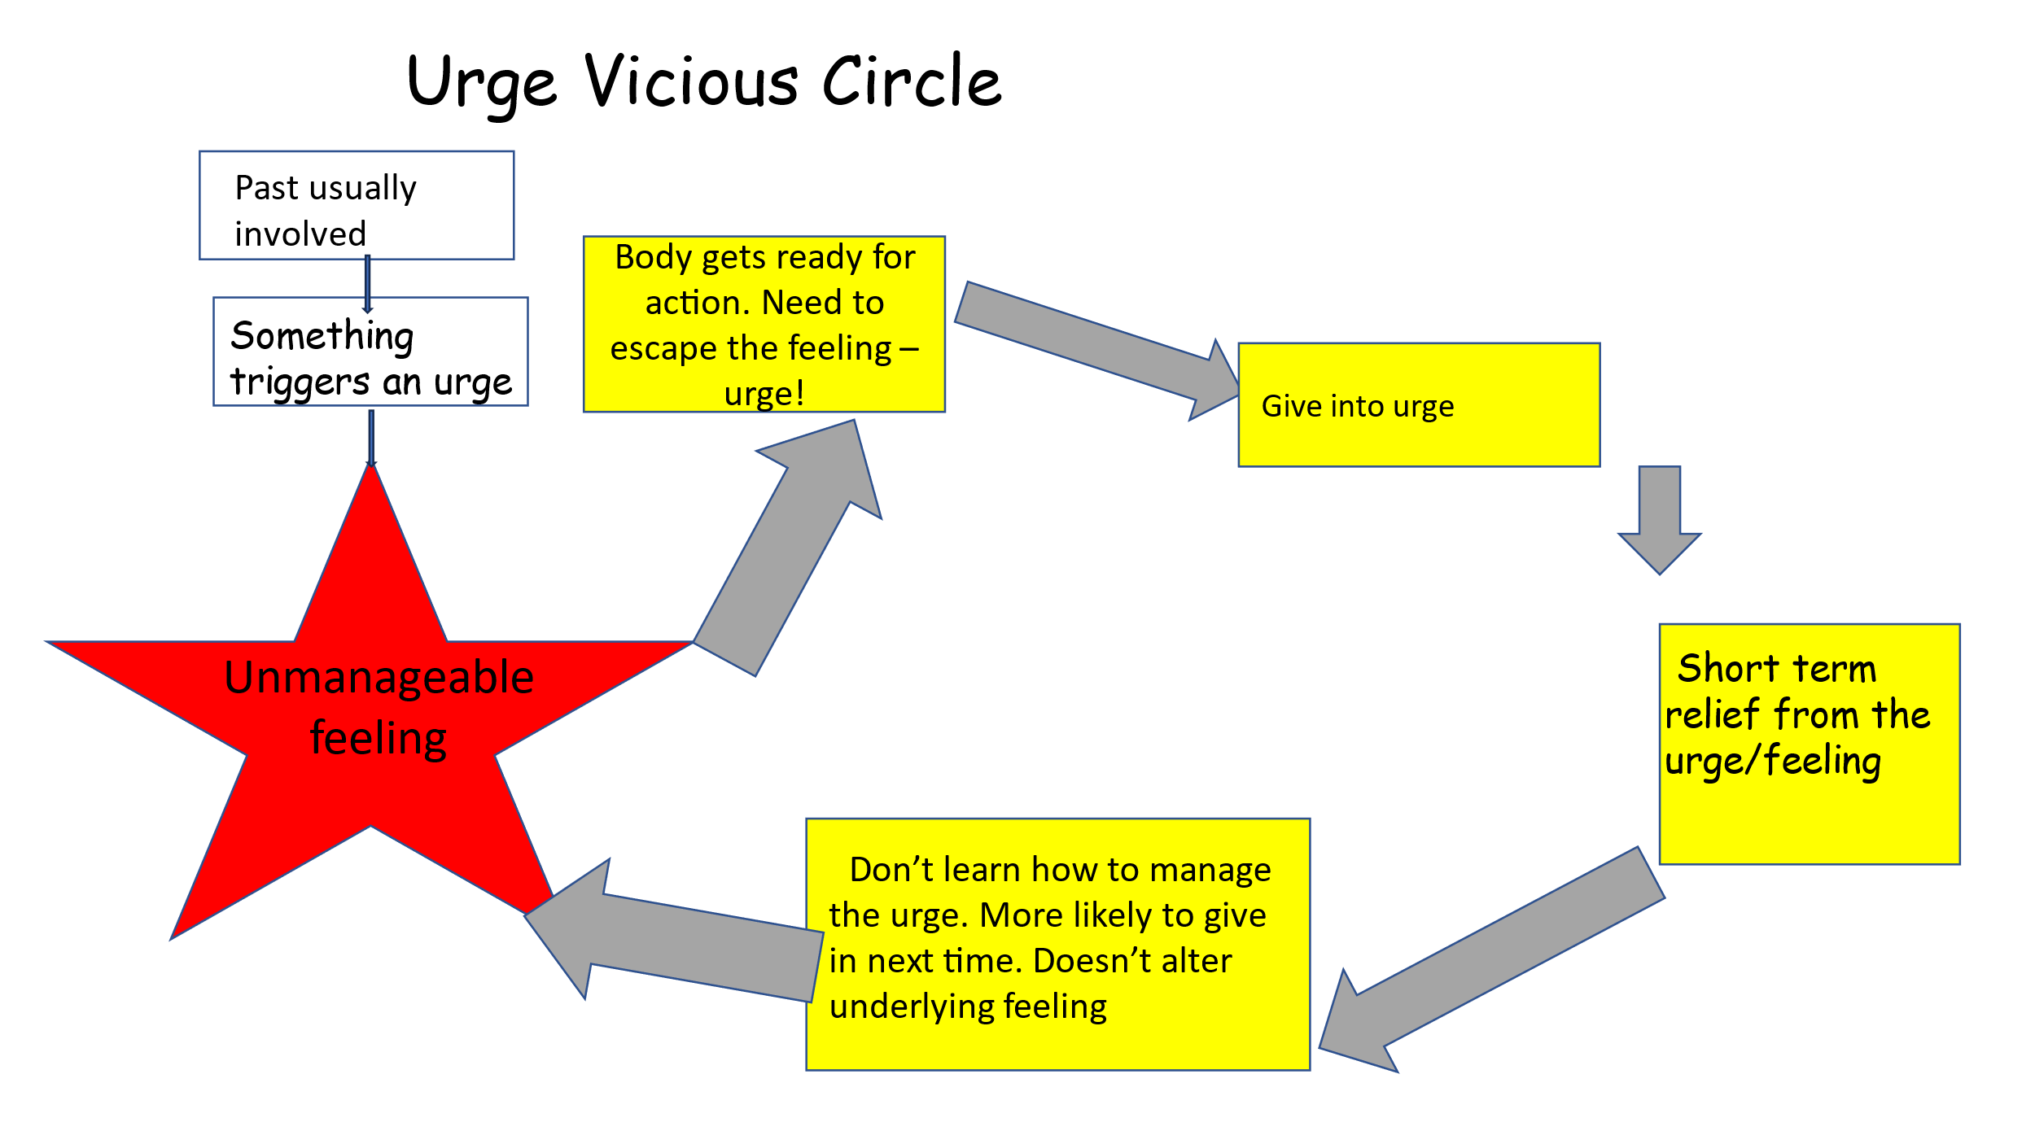
Session 4.Managing Urges and Distress.
When the urge is too strong:
DELAY DISTRACT DECIDE
Ways to distract (only a short term solution)?
Using all the senses
Vigorous activity
Examples of what might be possible on the ward.
Mindfulness of not popping bubble wrap (or smoothing hand cream; not eating chocolate etc.)
ACCEPTING. However much someone wants things to be different, they cannot start to make this happen until they really face and accept the way it is – this can be very difficult. Another thing staff can help people with by first validating how hard it is.
Notes:
Discussion on how staff can support people with this on the ward, suggest things.

Slide 8
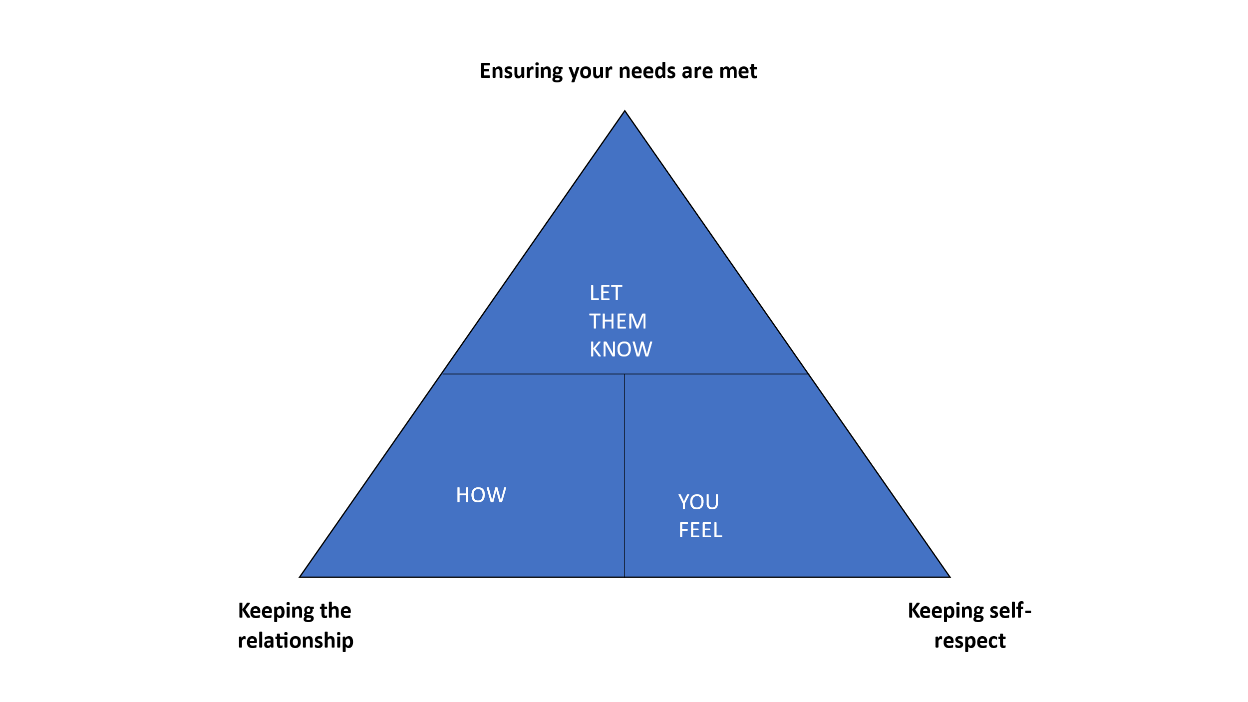
Session 5. People Skills 1.
FIRST people need to be clear, in any given interpersonal situation, where their priorities should lie.
They need to be in WISE MIND to do this – hard as relationship issues are emotive.
THEN
LET THEM KNOW covers assertiveness skills.
HOW looks at skills to manage the relationship well
YOU FEEL is about being true to yourself and your values – one that often gets missed.
A ROLE PLAY helps participants to think this through in an amusing way.
The relationship balancing act:
Notes:
Use the case of someone on the ward with relationship issues to illustrate how this works.

Slide 9
Session 6. People Skills 2 and Keeping it Up
The session starts with more on negotiating, and putting yourself in the other person’s shoes to help with this.
Then there is a recap of the course for people to consider which skills they need to prioritize
Followed by PERSONAL PLAN FOR KEEPING UP THE SKILLS
Chosen goals for:
1. Emotion Regulation: (e.g. increasing pleasurable events and STRENGTH):
2. Mindfulness Practice:
3.Managing Urges and Distress
4. People Skills (e.g. assertiveness, relationship building):
What/ who will support you?
What could get in the way?
And what would you do about it?
This is something you can help your patients with – they have a Diary Sheet to monitor how they are doing.

Slide 10
Any thoughts?
Any questions ?
How do you think you can support here?
All staff are most welcome to attend the group to find out what it is about – in the past these groups have been facilitated partly by nursing staff.

