Slide 1
COMPREHEND COPE AND CONNECT BITE-SIZED TRAINING
Managing your Safety System
(stress and anxiety)

Slide 2
Mental health problems like: panic, avoidance, self harm, voices and delusions etc – are either triggered by, or made worse by high or low arousal.
This is because we lose touch with Reasonable Mind at high and low arousal – so Emotion Mind can take over – along with the body.
REASONABLE
MIND
EMOTION
MIND
WISE
MIND
Emotion
Mind Memory
Reasonable
Mind Memory
IN THE PRESENT
IN CONTROL
Notes:
2
The diagram shows that our brains have 2 separate circuits. Emotion Mind manages feelings, information from our senses, and working out what is important for us. It is the one that registers a sense of threat – also happiness when things go well for us.
Reasonable Mind thinks logically. It knows about time and place and can see the bigger picture. The two work together most of the time, but separate when we are very stressed – or very relaxed. Mindfulness is the skill we need to bring them back together.
This diagram is used in Dialectical Behaviour Therapy, but the circles labelled memory have been added here, as they give information that we know from research into the way the brain operates that helps explain both why present feelings can become so unbearable.

Slide 3
Explanation for this: Human beings are designed for Survival
You have 2 settings
An ordinary, everything is safe setting (REASONABLE AND WISE MIND)
An emergency THREAT! Setting. (EMOTION MIND on its own)
This gets the body ready for immediate ACTION
Either: FLIGHT - run away/escape/avoid
Or FIGHT (get angry)
Or FREEZE (avoid/do nothing)
Does this mean there really is an emergency?
Almost certainly not – the system works on a ‘better safe than sorry’ principle.
You need your WISE MIND to decide
Notes:
Facilitator notes.
This is how it is presented to the group.

Slide 4
Understanding the Safety System
A figure is drawn on the board
The group are asked what they notice in their bodies when they are anxious, stressed, panicky etc – Fight/Flight
Each change is drawn onto the figure (eg. butterflies in stomach etc).
Emphasized: As the body gets ready for action through the familiar changes - this cuts out the bigger picture (Reasonable Mind)
Concentrates the mind on threat
Which of course is then found everywhere!
(And brings past threat into the present)
Notes:
Depending on time, you could illustrate this using the flip chart. Get some discussion about what they notice both in themselves and in their patients when fight/flight kicks in. Is it a good time for a discussion? Pointing things out etc.? The changes outlined in the group are pasted in here: Heart Rate. This speeds up.
Why? For vigorous action you need extra blood in all your limbs and organs – the heart achieves this by pumping the blood round faster.
You notice: Heart thumping
Feeling hot and sweaty.
Stomach and digestive system. Digestion etc is switched off.
Why? When there is an emergency, resources (blood) needs to be withdrawn from the less essential to the parts of the system that are vital for survival.
You notice: Varies: ‘butterflies’ – uncomfortable feeling in the stomach
Feeling sick
Needing the toilet.
Breathing. Breath in fast. Breath out less.
Why? When you engage in vigorous action, you need plenty of air, and you use it up quickly, hence gulping in air in rapid, short, breaths.
You notice: If (as is likely) you are not engaging in vigorous action, this sort of breathing will soon feel very uncomfortable. It will affect your ability to think normally (below); you could start to feel as if you cannot breath, which is itself frightening, so that if it continues, it can lead to the alarming (but not actually dangerous) experience of panic.
Muscles. These become tense.
Why? The extra blood and oxygen that has been provided is sent to the muscles so that your legs can run away fast or your arms fight effectively.
You notice: Feeling tense, sometimes leading to shaking and tremor in the limbs; pain if prolonged. Tension in the head and face muscles leads to headache.
Thinking. This becomes focused on threat (tunnel vision), fails to take in the bigger picture, and if prolonged, leads to confusion.
Why? If you are in real danger, you do need to concentrate on coping with that. The change in your breathing, disturbs the balance between oxygen and carbon dioxide in the brain – as a result of breathing for action without using that extra oxygen, and not breathing out enough. If this carries on, the brain cannot cope with it, and the result for you is panic and confusion.

Slide 5
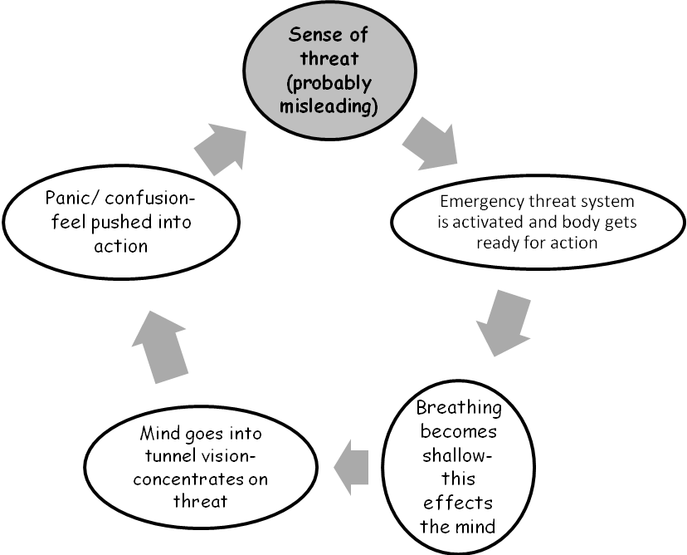
How high arousal gets locked in:THREAT VICIOUS CIRCLE

Slide 6
GETTING BACK INTO WISE MIND
Staff can remind and help patients follow the breathing and grounding exercises that follow.

Slide 7
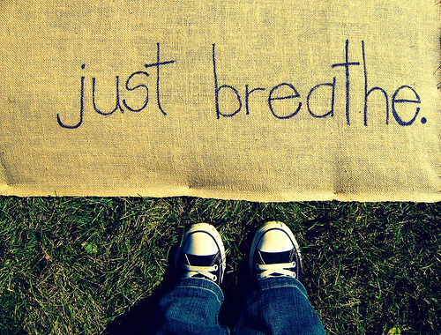
Relaxation Breathing
How to switch off the body’s ‘Action’ mode – getting ready for action means breathing in more than you breath out – so all you have to do to switch it off is the opposite!
THE BREATHING EXERCISE
I....n..../O......u.......t........
(out is twice as long as in).
Practice regularly
You naturally relax your chest muscles when breathing out:
I...n..../and R....e....l......a......xxxxxxxx
So, relax on the out breath – start with the shoulders
Notes:
‘ Take the group through the breathing and ask how it felt.
Add the following tips:
Keep practicing this so that it is easy to do when you really need it.
BREATHING WILL BRING DOWN ANXIETY IF YOU CATCH IT EARLY – NOTICE WHAT YOUR BODY IS TELLING YOU – PICK UP YOUR FIRST SIGNS OF ANXIETY, AND LENGTHEN YOUR BREATHING THEN
When you have breathed out, you don’t need to breath in again straight away (whatever it feels like). Take it easy. Don’t bother!
THIS BREATHING SHOULD HELP YOU TO THINK MORE CLEARLY.
PRACTICE
Practice is key. Practice this breathing at odd moments. Start practicing when you are quite relaxed, as it will not work if you start straight away with times when you are very tense. Get good at it, and then you can expect it to work for you when you need it.
Build some regular check in times into your day to practice the breathing – and use it when you want to get to sleep!

Slide 8
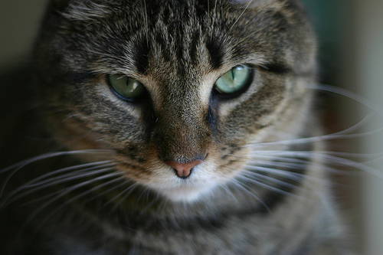
Using Mindfulness to take Charge in the Present
When you notice the threat system getting into gear – bring yourself into the present;
Notice everything – notice something in your surroundings you had not seen before
Notice what you can hear
If bothered by people – really look at them
Notice judgements and let them go
Notes:
Sometimes it is too difficult to remember how to do the breathing when stress levels are rising rapidly and it can be easier to simply ground yourself by noticing physical reality in the moment -
i.e. to add in mindfulness. Discussion of what people might really notice if, for instance, they avoid going into crowded places. because they fear people will look at them and judge them. If you really look at the other people in the supermarket, what would you see? Would they all be looking at you?
Some people find it most useful to breathe long slow outbreaths first, then ground themselves mindfully in the present. Others find it works better the other way round.

Slide 9
AVOIDANCE
Another vicious cycle, and one staff can help patients to get out of by graduated exposure to whatever is being avoided.

Slide 10
Sense of Threat and Avoidance
The Avoidance Cycle
The threat vicious circle has set in – panic level is reached or is near.
Thinking goes into tunnel vision – you fear the worst
Leave the situation
Relief – so more likely to avoid or leave early in future
Never experience the natural rise and fall of the anxiety curve; never gain confidence to cope
This becomes a repeating and self reinforcing cycle.
Role of chronic stress in making panic/loss of temper point more accessible
Notes:
Draw out the anxiety curve on the flipchart, emphasizing that you will not experience the natural lessening of the anxiety as the wave washes over unless you stick with it. If you either leave – or keep it around by worrying, it will appear unmanageable.
This is another example of how the threat reaction can take over and rule your life if you let it.
Get examples from the group of situations that people might avoid because they become anxious in them. (Normalize wish to avoid things like the dentist and exams; note where people avoid in situations where most people do not have a problem).

Slide 11
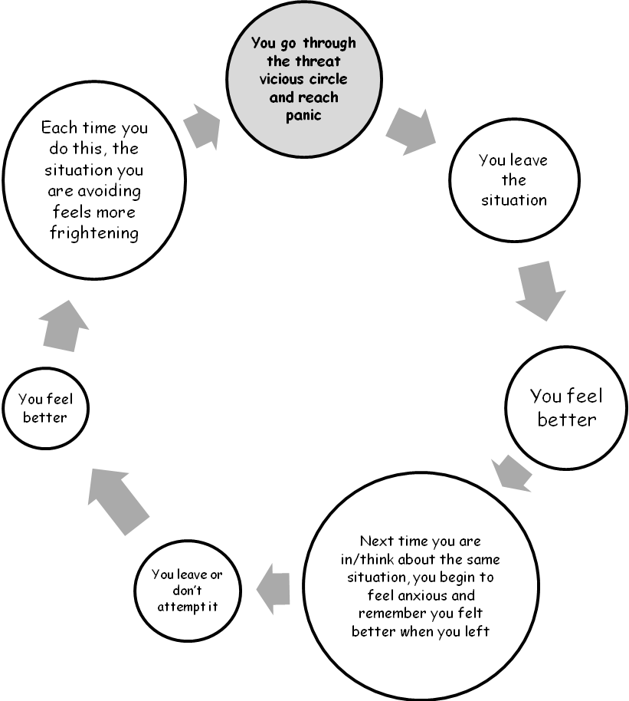
AVOIDANCE VICIOUS CIRCLE
Notes:
When going round the diagram, ask ‘If you look for threat, what are you likely to find?
Get an example from the group and work through on flipchart or template if virtual.
Stress how common avoidance cycles are, and how powerful they are in keeping you stuck. It means you never build up confidence to face the situation, so that life can become ruled by fear.
Get examples of this from the group
List of things they need to stop avoiding

Slide 12
This is something you can work through with your patients in one to ones.
BEATING AVOIDANCE
Make a list of things you are avoiding
Put it in order – least scary to most scary
Promise yourself that you will try the least scary
Use breathing and mindfulness to make it easier
Congratulate yourself when you have done it!
Carry on up the list as your confidence grows.
TIPS FOR MAKING THE MOST OF THE BREATHING
Catch it early!
To manage that you need to Read your body! Be aware of changes that mean the threat system is kicking in.
Be aware of your early warning sign – what you notice first (stomach? Shoulders? Etc.)
The moment you notice it: Start breathing OUT
Notes:
Discussion on creating this hierarchy – get an example from someone of their list.

Slide 13
Session 2 CHRONIC STRESS

Slide 14
CHRONIC STRESS
If your threat system gets triggered a lot, stress levels can stay high most of the time. This has a number of bad results. Your body does not work well in emergency setting.
It is a bit like driving your car along the motorway in second gear. You need second gear for going round obstacles, but if you use it all the time, it is bad for the engine and very uncomfortable. Chronic stress is like that.
Also, it means that it only takes something quite small to trigger either panic, or loss of temper – where the sensible, ‘Reasonable Mind’ gets switched off, and the person ‘Loses it; panic takes over.
For someone more laid back, it takes a lot to push them over that limit.

Slide 15
EFFECT OF ONGOING STRESS LEVEL ON LOSS OF TEMPER/PANIC
Point of loss of temper/panic
Minor event
High ongoing stress level
Low ongoing
stress level
Major stressful event
Notes:
Explain the diagram. Everyone has a point at which they will flip – either reach panic or lose their temper, if put under sufficient stress or threat – there are physiological reasons for this. However, if their underlying level of stress is low it will take an awful lot reach that point. If someone is running at a constant high level of stress, it will take very little.
Generate discussion and get some examples of ‘straw that breaks the camel’s back’ situations.
This can be an opportunity to bring in anger and loss of temper and link that to the stress reaction.
The solution is to reduce ongoing stress in your life.
Discussion around what produces stress and what reduces it – flip chart.

Slide 16

The next two slides cover things you can work on during one to ones.
Life Style and chronic stress
  What changes might you need to make?
  Too many stresses – problem solve cutting down (next slide)
  Too little meaningful activity, too little contact with others etc. (also stressful)
  If you are a sensitive person, you might need to limit things that other don’t find too much (crowds, stimulation etc.)
Notes:
Pair exercise. Discuss with partner what life style elements are causing stress – what might they need to do less of:
What life style changes might bring down or relieve stress – what might they need to do more of.
Tip: as stress is about the body getting ready for action, giving it some activity whether sport or practical is a good start.
Starting point for individual plans.

Slide 17
Making a stress management plan
Need less of – list the pressures that increase stress in your life.
Sort them out into ones you can do something about
Ones you cannot.
Things you need more of.
What do you need to build into your life to manage stress?
E.g. Exercise (but don’t overdo it)
Pleasant, soothing activities
Etc.

Slide 18
THE THREAT SYSTEM AND SURVIVAL
Question: Why does our threat system cause so much trouble?
Answer: Because we are designed for survival in a cave man environment. When life was simple, it was important to recognise threats to survival (wild animals, hostile tribes etc.) and respond to them rapidly.
So, we are equipped with a short cut system to do that. It cuts out Reasonable Mind – slow thinking that takes too long if the danger is immediate. It lays down a memory of threat that is immediately triggered if something that reminds us of past threat happens again.

Slide 19
THE THREAT SYSTEM AND THE MEMORY
So, threat memory – Emotion Mind – does not “do” time. It mixes up “then” and “now”.
So, when your threat system is triggered, not only are you dealing with the current emergency, all the bad things that happened in the past can come rushing back, making it 10 times worse.....
This is one of the many good reasons for putting the threat system in its place – or it keeps the past and everything that went wrong in the past alive for you forever. This keeps you feeling bad.

Slide 20
Your 2 settings.
REASONABLE
MIND
EMOTION
MIND
WISE
MIND
Reasonable
Mind Memory
Emotion
Mind Memory
IN THE PRESENT
IN CONTROL
Notes:
20

Slide 21
How do you see yourselves helping your patients to manage their state of arousal?
Any of this helpful for you – after all, we all have safety systems!
Thank you for participating – the CCC programme is about making you partners in therapy delivery.
HOW TO PUT THE THREAT SYSTEM IN ITS PLACE.
Immediate coping. - Breathing. Giving you space. Think.
Challenge avoidance - dismantle it bit by bit.
Develop a low stress lifestyle
Remember, too little challenge can be as stressful as too much sometimes, so find activity that feels meaningful and worthwhile for you - just enough pressure, but not too much!.

