Slide 1
COMPREHEND COPE AND CONNECT
Your Safety System a User’s Guide
How to manage stress and anxiety
Session 1

Slide 2
Welcome
Group rules
Ask them about their anxiety and how it affects

Slide 3
Human beings are designed for Survival
You have 2 settings
An ordinary, everything is safe setting (REASONABLE AND WISE MIND)
An emergency THREAT! Setting. (EMOTION MIND on its own)
This gets the body ready for immediate ACTION
Either: FLIGHT - run away/escape/avoid
Or FIGHT (get angry)
Or FREEZE (avoid/do nothing)
Does this mean there really is an emergency?
Almost certainly not – the system works on a ‘better safe than sorry’ principle.
You need your WISE MIND to decide
Notes:
Facilitator notes.
Ask the group the question: Does this mean there really is an emergency?

Slide 4
Your 2 settings.
REASONABLE
MIND
EMOTION
MIND
WISE
MIND
Reasonable
Mind Memory
Emotion
Mind Memory
IN THE PRESENT
IN CONTROL
Notes:
4
The diagram shows that our brains have 2 separate circuits. Emotion Mind manages feelings, information from our senses, and working out what is important for us. It is the one that registers a sense of threat – also happiness when things go well for us.
Reasonable Mind thinks logically. It knows about time and place and can see the bigger picture. The two work together most of the time, but separate when we are very stressed – or very relaxed. Mindfulness is the skill we need to bring them back together.
This diagram is used in Dialectical Behaviour Therapy, but the circles labelled memory have been added here, as they give information that we know from research into the way the brain operates that helps explain both why present feelings can become so unbearable.

Slide 5
Things you might do differently because of stress and anxiety?
Does it stop you doing things?
Do you find yourself doing things you later regret because you feel stressed?
Notes:
Group discussion. Go round the participants if a small group.
Split into 2s and then bring together if a large group.

Slide 6
Understanding your body’s safety system
When you feel under threat,
Your body gets ready for action
How do you know when that is happening?
THREAT!!!
Think of times when that has happened recently – Were you really under threat?
Remember, our bodies go on a ‘better safe than sorry’ principle – when in doubt they get ready for action – like the sort of burglar alarm that goes off when the cat works past
Notes:
Draw a rough outline of a person (not a stick figure) on the flip chart, or use the template (next slide) if delivered virtually.
Ask the group how they know their bodies are getting ready for action; what feels different.
Collect what people experience when they feel under threat, when fight and flight kicks in, and draw each one in the appropriate place on the drawing:
e.g. draw butterflies in the stomach area for butterflies in the stomach; lines parallel to limbs that feel tense, drops of water coming off the hands for sweat etc. (use words if you really cannot represent it visually).
Discussion of times when this might happen.

Slide 7

A
A
A
A
A
A
A

Slide 8
Action Mode
Heart Rate. This speeds up.
Why? For vigorous action you need extra blood in all your limbs and organs – the heart achieves this by pumping the blood round faster.
You notice: Heart thumping
Feeling hot and sweaty.
Stomach and digestive system. Digestion etc is switched off.
Why? When there is an emergency, resources (blood) needs to be withdrawn from the less essential to the parts of the system that are vital for survival.
You notice: Varies: ‘butterflies’ – uncomfortable feeling in the stomach
Feeling sick
Needing the toilet.
Notes:
Draw an outline figure on the flipchart here and draw on the different signs of arousal that people bring.

Slide 9
Action Mode cont.
Breathing. Breath in fast. Breath out less.
Why? When you engage in vigorous action, you need plenty of air, and you use it up quickly, hence gulping in air in rapid, short, breaths.
You notice: If (as is likely) you are not engaging in vigorous action, this sort of breathing will soon feel very uncomfortable. It will affect your ability to think normally (below); you could start to feel as if you cannot breath, which is itself frightening, so that if it continues, it can lead to the alarming (but not actually dangerous) experience of panic

Slide 10
Action Mode cont.
Muscles. These become tense.
Why? The extra blood and oxygen that has been provided is sent to the muscles so that your legs can run away fast or your arms fight effectively.
You notice: Feeling tense, sometimes leading to shaking and tremor in the limbs; pain if prolonged. Tension in the head and face muscles leads to headache.
Thinking. This becomes focused on threat (tunnel vision), fails to take in the bigger picture, and if prolonged, leads to confusion.
Why? If you are in real danger, you do need to concentrate on coping with that. The change in your breathing, disturbs the balance between oxygen and carbon dioxide in the brain – as a result of breathing for action without using that extra oxygen, and not breathing out enough. If this carries on, the brain cannot cope with it, and the result for you is panic and confusion.

Slide 11
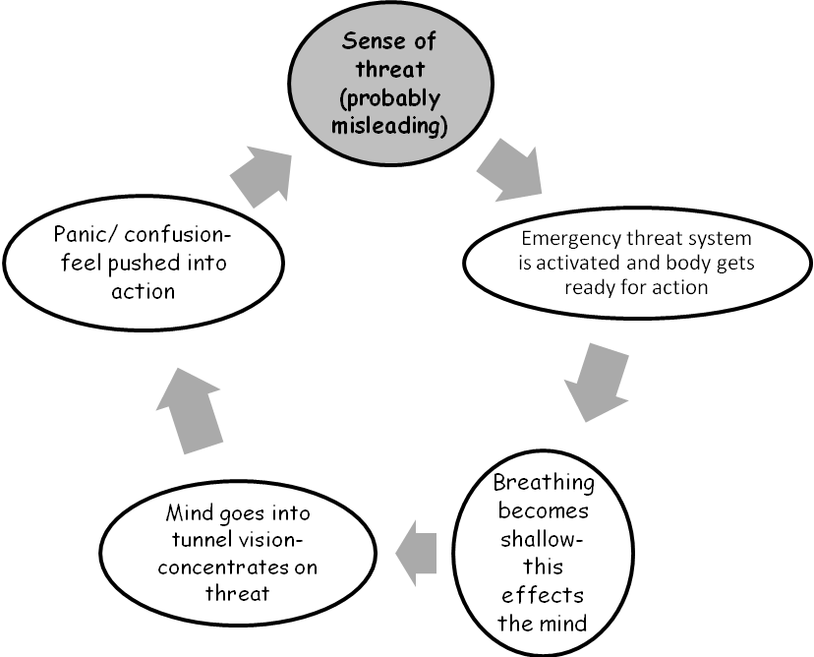
It is easy to get trapped in this
THREAT VICIOUS CIRCLE
Notes:
Go through the vicious circle stage by stage – can be useful to draw it out on the flipchart. Explain that this is how Emotion Mind manages to take control and take you away from Reasonable Mind . When the mind goes into tunnel vision and looks for threat – ask the group, what are you likely to find if you look for threat?? This way, paranoia!

Slide 12
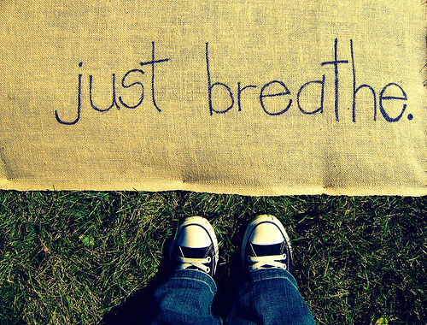
Relaxation Breathing
How to switch off the body’s ‘Action’ mode – getting ready for action means breathing in more than you breath out – so all you have to do to switch it off is the opposite!
THE BREATHING EXERCISE
I....n..../O......u.......t........
(out is twice as long as in).
Practice regularly
You naturally relax your chest muscles when breathing out:
I...n..../and R....e....l......a......xxxxxxxx
So, relax on the out breath – start with the shoulders
Notes:
‘ Take the group through the breathing and ask how it felt.
Add the following tips:
Keep practicing this so that it is easy to do when you really need it.
BREATHING WILL BRING DOWN ANXIETY IF YOU CATCH IT EARLY – NOTICE WHAT YOUR BODY IS TELLING YOU – PICK UP YOUR FIRST SIGNS OF ANXIETY, AND LENGTHEN YOUR BREATHING THEN
When you have breathed out, you don’t need to breath in again straight away (whatever it feels like). Take it easy. Don’t bother!
THIS BREATHING SHOULD HELP YOU TO THINK MORE CLEARLY.
PRACTICE
Practice is key. Practice this breathing at odd moments. Start practicing when you are quite relaxed, as it will not work if you start straight away with times when you are very tense. Get good at it, and then you can expect it to work for you when you need it.
Build some regular check in times into your day to practice the breathing – and use it when you want to get to sleep!

Slide 13
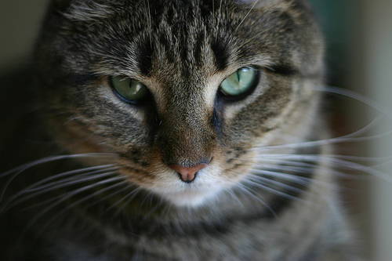
Using Mindfulness to take Charge in the Present
When you notice the threat system getting into gear – bring yourself into the present;
Notice everything – notice something in your surroundings you had not seen before
Notice what you can hear
If bothered by people – really look at them
Notice judgements and let them go
Notes:
Sometimes it is too difficult to remember how to do the breathing when stress levels are rising rapidly and it can be easier to simply ground yourself by noticing physical reality in the moment -
i.e. to add in mindfulness. Discussion of what people might really notice if, for instance, they avoid going into crowded places. because they fear people will look at them and judge them. If you really look at the other people in the supermarket, what would you see? Would they all be looking at you?
Some people find it most useful to breathe long slow outbreaths first, then ground themselves mindfully in the present. Others find it works better the other way round.

Slide 14
Sense of Threat and Avoidance
The Avoidance Cycle
The threat vicious circle has set in – panic level is reached or is near.
Thinking goes into tunnel vision – you fear the worst
Leave the situation
Relief – so more likely to avoid or leave early in future
Never experience the natural rise and fall of the anxiety curve; never gain confidence to cope
This becomes a repeating and self reinforcing cycle.
Role of chronic stress in making panic/loss of temper point more accessible
Notes:
Draw out the anxiety curve on the flipchart, emphasizing that you will not experience the natural lessening of the anxiety as the wave washes over unless you stick with it. If you either leave – or keep it around by worrying, it will appear unmanageable.
This is another example of how the threat reaction can take over and rule your life if you let it.
Get examples from the group of situations that people might avoid because they become anxious in them. (Normalize wish to avoid things like the dentist and exams; note where people avoid in situations where most people do not have a problem).

Slide 15
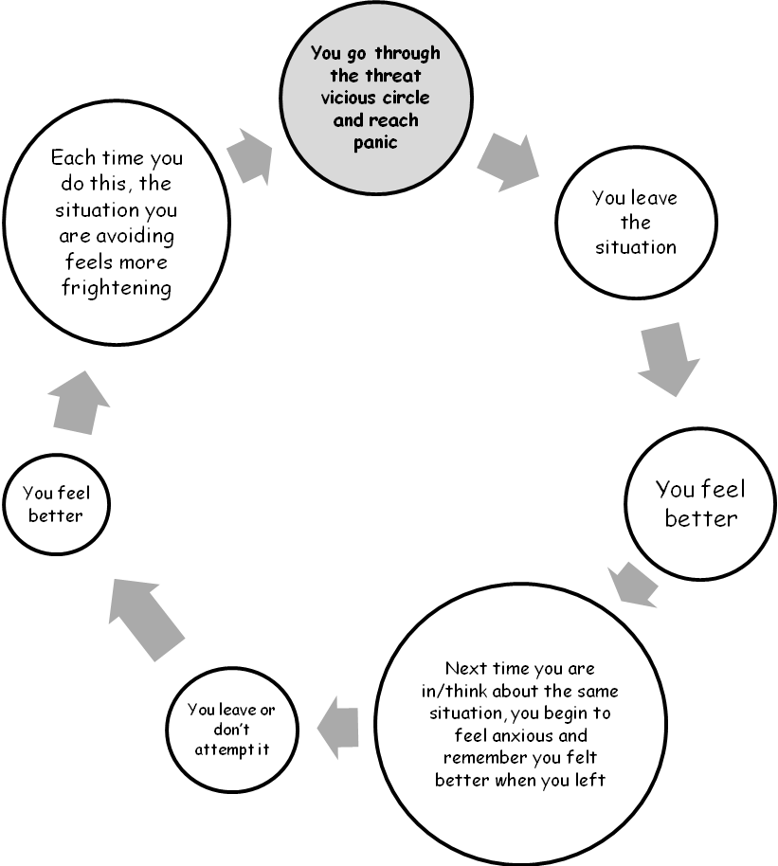
AVOIDANCE VICIOUS CIRCLE
Notes:
When going round the diagram, ask ‘If you look for threat, what are you likely to find?
Get an example from the group and work through on flipchart or template if virtual.
Stress how common avoidance cycles are, and how powerful they are in keeping you stuck. It means you never build up confidence to face the situation, so that life can become ruled by fear.
Get examples of this from the group
List of things they need to stop avoiding

Slide 16
Beating Avoidance
Make a list of things you are avoiding
Put it in order – least scary to most scary
Promise yourself that you will try the least scary
Use breathing and mindfulness to make it easier
Congratulate yourself when you have done it!
Carry on up the list as your confidence grows.
Notes:
Discussion on creating this hierarchy – get an example from someone of their list.

Slide 17
Homework
Practice the breathing
Identify one thing you have been avoiding and do it!

Slide 18
COMPREHEND COPE AND CONNECT
Your Safety System a User’s Guide
How to manage stress and anxiety
Session 2

Slide 19
Feedback from Homework
How have people got on with practicing breathing?
Using breathing and mindfulness in tense situations?
Any problems?
What about doing something you had been avoiding?
Notes:
Discuss problems with breathing and mindfulness. Some people find it easier to start with one, some the other.
Difficult to lengthen breathing when in a state of panic – noticing first sign of tension is important here, so starting to attend to how your body is feeling.
A balance is needed here – there is also a danger in becoming preoccupied with this. Mindfulness of surroundings can help here.
Avoidance. Congratulations for any successes.
Possible problems. Trying something too difficult? How could they break it down.
Must feel sustainable – so watch for ‘Phew, I got away with it that time’ – sign of starting too high up the hierarchy.
Motivator: reduce the power anxiety has over their lives.

Slide 20
Tips for making the most of the breathing
Catch it early!
To manage that you need to Read your body! Be aware of changes that mean the threat system is kicking in.
Be aware of your early warning sign – what you notice first (stomach? Shoulders? Etc.)
The moment you notice it: Start breathing OUT

Slide 21
CHRONIC STRESS
If your threat system gets triggered a lot, stress levels can stay high most of the time. This has a number of bad results. Your body does not work well in emergency setting.
It is a bit like driving your car along the motorway in second gear. You need second gear for going round obstacles, but if you use it all the time, it is bad for the engine and very uncomfortable. Chronic stress is like that.
Also, it means that it only takes something quite small to trigger either panic, or loss of temper – where the sensible, ‘Reasonable Mind’ gets switched off, and the person ‘Loses it; panic takes over.
For someone more laid back, it takes a lot to push them over that limit.

Slide 22
EFFECT OF ONGOING STRESS LEVEL ON LOSS OF TEMPER/PANIC
Point of loss of temper/panic
Minor event
High ongoing stress level
Low ongoing
stress level
Major stressful event
Notes:
Explain the diagram. Everyone has a point at which they will flip – either reach panic or lose their temper, if put under sufficient stress or threat – there are physiological reasons for this. However, if their underlying level of stress is low it will take an awful lot reach that point. If someone is running at a constant high level of stress, it will take very little.
Generate discussion and get some examples of ‘straw that breaks the camel’s back’ situations.
This can be an opportunity to bring in anger and loss of temper and link that to the stress reaction.
The solution is to reduce ongoing stress in your life.
Discussion around what produces stress and what reduces it – flip chart.

Slide 23

Life Style and chronic stress
What changes might you need to make?
Too many stresses – problem solve cutting down (next slide)
Too little meaningful activity, too little contact with others etc. (also stressful)
If you are a sensitive person, you might need to limit things that other don’t find too much (crowds, stimulation etc.)
Notes:
Pair exercise. Discuss with partner what life style elements are causing stress – what might they need to do less of:
What life style changes might bring down or relieve stress – what might they need to do more of.
Tip: as stress is about the body getting ready for action, giving it some activity whether sport or practical is a good start.
Starting point for individual plans.

Slide 24
Making a stress management plan
Need less of – list the pressures that increase stress in your life.
Sort them out into ones you can do something about
Ones you cannot.
Things you need more of.
What do you need to build into your life to manage stress?
E.g. Exercise (but don’t overdo it)
Pleasant, soothing activities
Etc.

Slide 25
THE THREAT SYSTEM AND SURVIVAL
Question: Why does our threat system cause so much trouble?
Answer: Because we are designed for survival in a cave man environment. When life was simple, it was important to recognise threats to survival (wild animals, hostile tribes etc.) and respond to them rapidly.
So, we are equipped with a short cut system to do that. It cuts out Reasonable Mind – slow thinking that takes too long if the danger is immediate. It lays down a memory of threat that is immediately triggered if something that reminds us of past threat happens again.

Slide 26
THE THREAT SYSTEM AND THE MEMORY
So, threat memory – Emotion Mind – does not “do” time. It mixes up “then” and “now”.
The body takes over – you go into Fight or Flight
So, when your threat system is triggered, not only are you dealing with the current emergency, all the bad things that happened in the past can come rushing back, making it 10 times worse.....
This is one of the many good reasons for putting the threat system in its place – or it keeps the past and everything that went wrong in the past alive for you forever. This keeps you feeling bad.

Slide 27
Your 2 settings
EMOTION
MIND
REASONABLE
MIND
BODY
WISE
MIND
Reasonable
Mind Memory
Emotion
Mind Memory
IN THE PRESENT
IN CONTROL
Notes:
27
Take them through this, adding memory second. Added from ICS model of cognitive architecture which is not gone into here, but more on that in the book and on my website.

Slide 28
Discussion
Examples of your threat system reacting to the past rather than the present
And keeping the past alive if you go along with it!

Slide 29
HOW TO PUT THE THREAT SYSTEM IN ITS PLACE.
Immediate coping. - Breathing. Giving you space. Think.
Challenge avoidance - dismantle it bit by bit.
Develop a low stress lifestyle
Remember, too little challenge can be as stressful as too much sometimes, so find activity that feels meaningful and worthwhile for you - just enough pressure, but not too much!.

Slide 30
Summing up
What have you got out of the programme?
What changes do you think you can make?
YOU RULE OK! NOT YOUR ANXIETY!

